Slide 1
Introduction to PEVs
Dan Hillary

Slide 2
Topics
PEVs in general
Could you use one?
Electric unicycles in particular
Questions

Slide 3
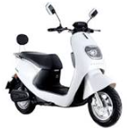
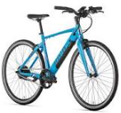
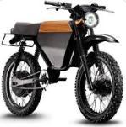
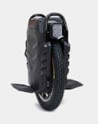
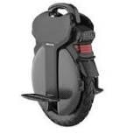
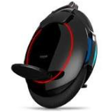
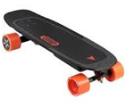
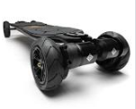
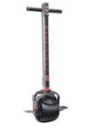
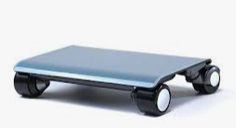
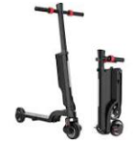
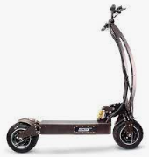
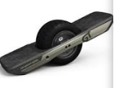
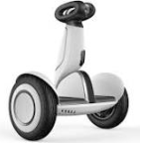
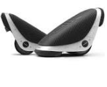
What’s a PEV?
Personal Electric Vehicle
E-bike
E-skateboard
E-scooter
E-moped
E-unicycle
- Whatever this is
And more!

Slide 4
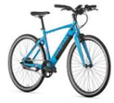
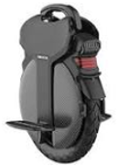
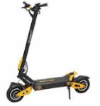
PEV Type Comparison
 | Cost Range | Pros | Cons
Bikes/Mopeds | $1k - $10k+ | Ease of use, safe and sturdy | Cost, size, weight
Esk8s | $400 - $2k+ | Small, familiar to skaters, customizable | In-hand controller, wheel size
Self-Balancing | $1k - $4k | Small, performance per $, fast charging | Learning curve, no “entry level” prices
E-Scooters | $500 - $8k+ | Ease of use, “foldable” | Size, weight, wheel size

Slide 5
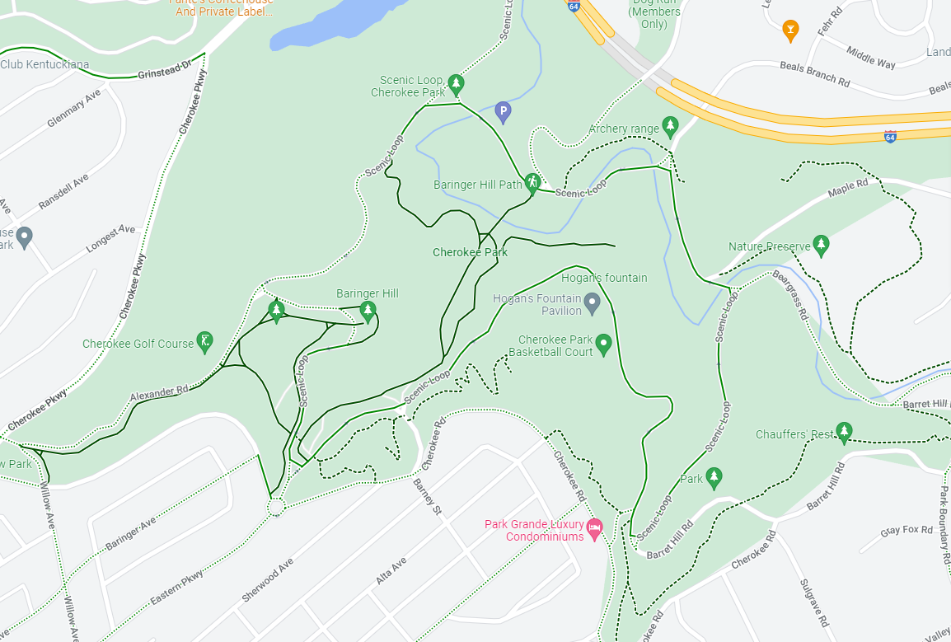
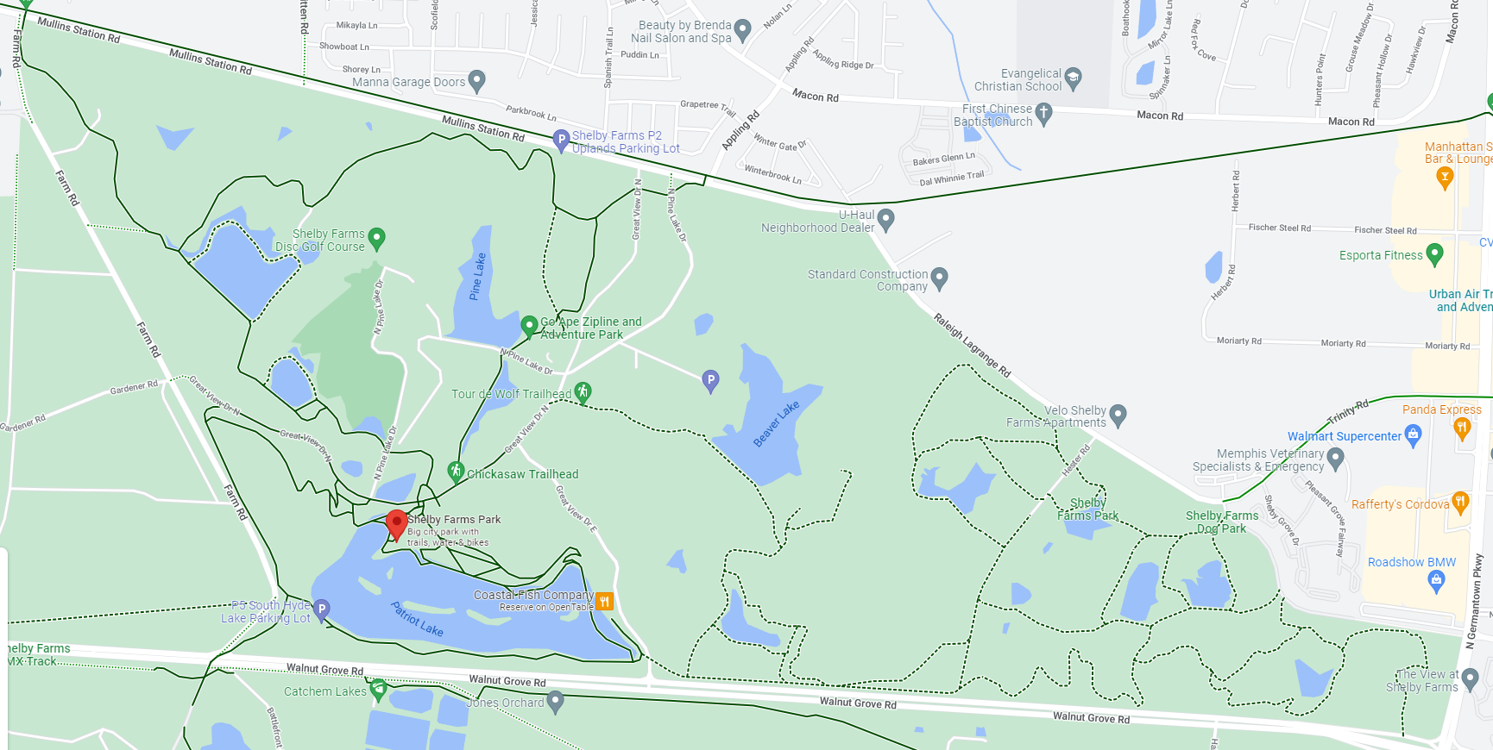
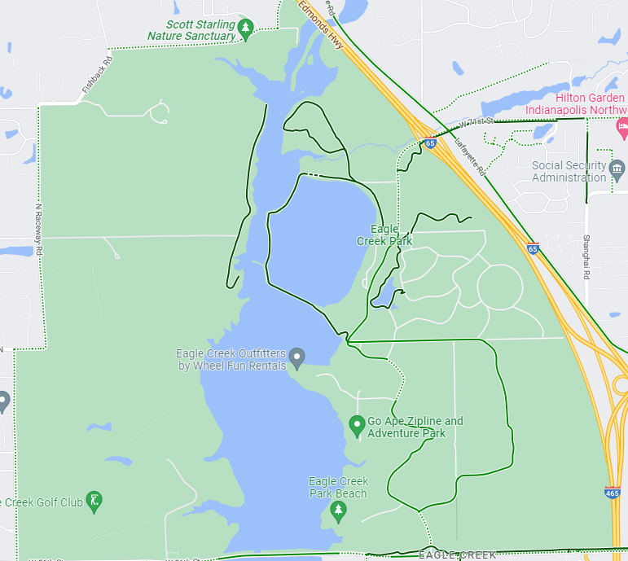
Could you use a PEV?
Do you ever have to park your car farther than you’d prefer to walk?
Music festivals, state fairs, Thunder over Louisville, etc.
Want to spend time in nature?
Cherokee Park, Louisville, 400+ acres, 10+ miles of multi-use trails and paths
Shelby Farms Park, Memphis, 4,500 acres, 10+ miles of trails and paths
Eagle Creek Park, Indianapolis, 3,900 acres, 4 miles of bikeable trails
Etc.
- Want to explore a city center?
Travel to a new city.
1
Find a free parking spot (maybe even with charging).
2
Pull your PEV out/off of your EV.
3
Explore your desired points of interest without having to re-park.
4
Return to your EV, pack PEV, head home!
5

Slide 6
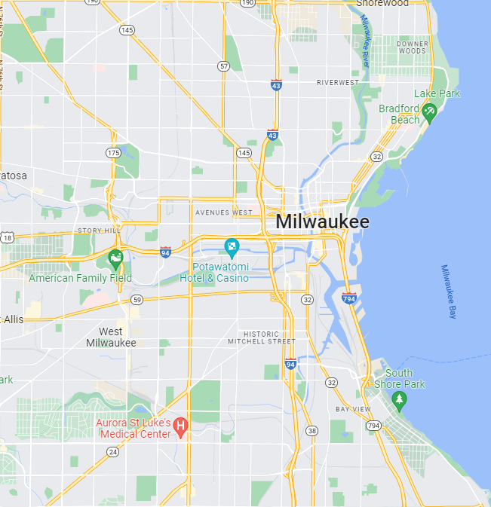
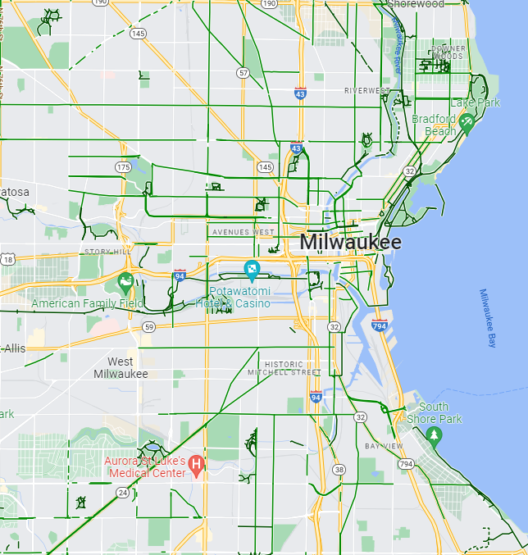
The Last Mile: how to get around on a PEV
Cities of the future
Legality?
“Bike mode” in Google Maps
Walkable, bikeable spaces in cities are growing; don’t miss out!
Depends on location.
Most state/municipal laws don’t specifically deal with PEVs in general
Safe rule of thumb is to look at e-bike laws.
Ebikes usually separated into class I, II, III
Class II pretty much legal everywhere, class III in only a majority of states/cities.

Slide 7
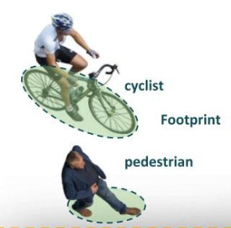
Why I Ride an EUC
Size is my priority
the “back seat footwell” test
Pedestrian footprint ratio
I don’t want to bring a bike lock
The Performance Edge
High voltage means faster charging
More batteries, less wasted space
Excellent conversation piece!
Everyone asks about it

Slide 8
Thank you!
Dan Hillary
Dan.t.Hillary@gmail.com
“Electric Riders of Louisville” Facebook group
Ewheels.com/LounicycleDan

Slide 9
Questions

